Slide 1
FINTECH 540
Guidelines for the ML Project
Fall Semester 2025

Slide 2
An Open-End Project: Unlock Insights from financial Data
Uniform Starting Point: All groups will choose from two available datasets.
Flexible Objectives: Your team can choose to focus on either a classification or a regression problem. You may specialize in a specific algorithmic approach or compare multiple methods.
Your project needs to analyze:
Blockchain or volatility DATA

Slide 3
DATA AND MATERIALs
Dataset Choices:
Option 1: Token Transfer Data on the Ethereum Blockchain for 1000 blocks.
Option 2: A collection of realized volatility estimates for the Dow Jones Industrial Average (DJIA) from 2003 onward. More details available at this repository.
Additional Data Sources
Bloomberg, FactSet, etc.: Explore databases available at the Ford Library for supplementary data.
Dataset Integration:
Uniform Starting Point: All groups will receive the same foundational dataset but are encouraged to enrich it by integrating additional data sources.

Slide 4
IDEAS to integrate the dataset
Market Metrics: Short & long-term Moving Averages, Technical indicators.
Volume: Trade volumes, Order Book Data.
Macro Indicators: Interest rates, GDP, unemployment, CPI.
News & Sentiment: Financial news APIs, social media data.
Earnings: Reports, upcoming announcements.
Alt Data: Weather, satellite imagery.
Forex & Commodities: Exchange rates, key commodity prices

Slide 5
IDEAS for ML applications
Token Transfer Classification: Predict which kind of transfer happens for a given txs_hash by looking at the addresses that interacts.
Volatility Forecast: Predict realized volatility for the DJIA cross-section using past market data.
Market Regime: Classify regimes (low-vol, high-vol).
Anomaly Detection: Detect unusual patterns in blockchain data or volatility using unsupervised learning techniques.
These are just starting points. Begin by exploring your data and then decide on the most compelling problem to investigate.

Slide 6
ORGANIZATION
The last two lectures will be dedicated to project presentations. Four groups will present in each session
20 minutes for each group + 5 min for questions.
Each group comprises 5 or 6 students for a total of 6 groups.
Participation and attendance, when others are presenting, are MANDATORY. Groups will be made available on Canvas after class.
Each group needs to send a written report, slides and supplementary material (codes) by the deadline.

Slide 7
What are you supposed to do then?
Use techniques covered in class for your models, although feel free to incorporate methods not yet discussed if capable.
Begin with specific research hypotheses, like ‘Future volatilities may be autocorrelated at 10 and 15 lags,' and proceed to test them.
You can start from existing research and try to develop something along those lines.

Slide 8
SHAPE OF THE DESIRED OUTPUT
Prepare a slide presentation summarizing your results, covering all phases from EDA to testing. Code inclusion is encouraged.
In addition to the presentation, submit a report (maximum 4 pages) detailing your approach, methodologies, and key findings.
You'll have 20 minutes for the presentation, plus 5 minutes for Q&A.
Remember that you have only 20 minutes. Be direct to the point.

Slide 9
Grading
I will assign the grade as follows:
• 60% efficacy and creativity of the technical (algorithmic) solution based on the written report and the presentation.
• 40% oral presentation.
A peer review evaluation will adjust individual grades.
This project constitutes 25% of your final grade.

Slide 10
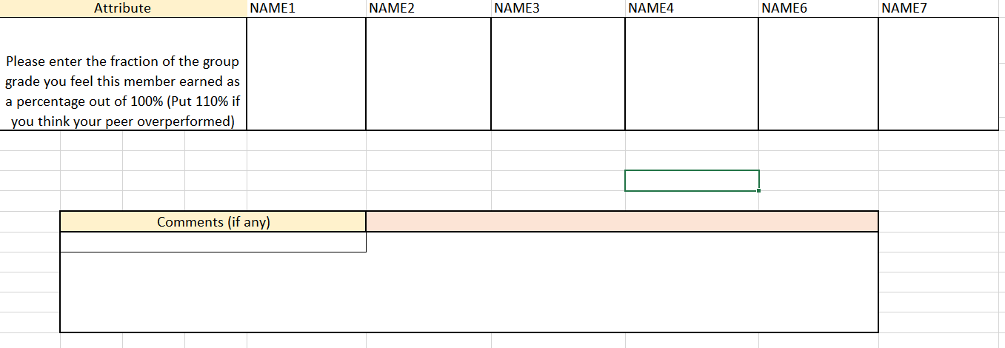
Peer Review Grading
Each team member will be awarded their own individual grade derived from the overall grade based on a peer review questionnaire. The questionnaire will ask that each team member rate the other team members as a percentage out of 100% based on that team member’s contribution to the project.

Slide 11
Next steps
Assignments: Teams are posted on Canvas under this week module called “XGBoost and Tree Ensembles - How to Start a Machine Learning Project”. It is your responsibility to check your team assignment.
Next Steps:
Elect a Team Leader internally.
Inform the TAs with an email and they will take notes of your chosen leader.
Deadline: Team leaders must be elected by the end of this week.
Note: Failure to choose a leader will result in a random selection.

